Slide 1
January, 10

Slide 2
Warm – up activity. Read and say the following words.
[au]- out, about ,house , found, cloud, thousand, south, ground
[dJ]- large, college, village, language, just, juice, jam, June, July

Slide 4
The Discovery of America

Slide 5
Vocabulary
To discover-V
Discovery- N (what?)
Discoverer-N (who?)
1.A. Nikitin was a…
2.Every day we…much at school.
3.The…of space is one of the greatest.

Slide 6
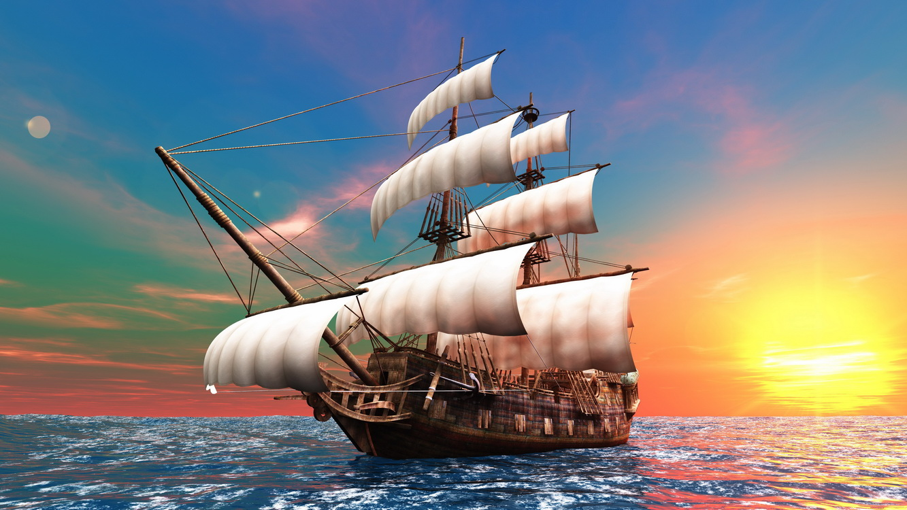
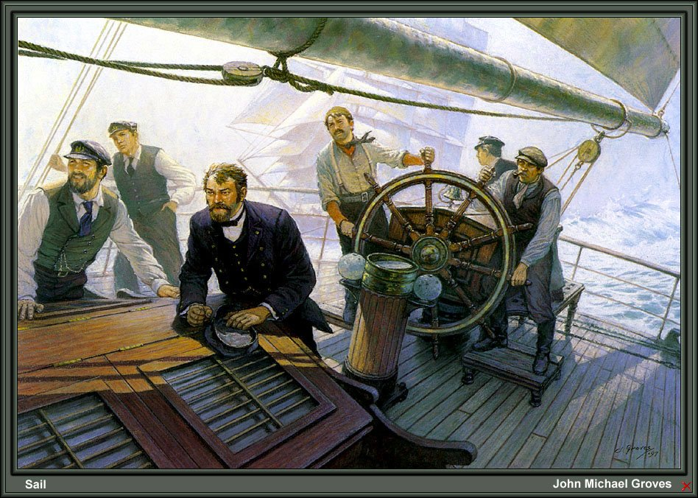
To sail
A crew

Slide 7
To reach

Slide 8
Correct the false statements
True+ False-
1.Christopher Columbus
discovered America in 1493.
2.He was born in England
3.His father and both
grandfathers were cloth makers
4.Columbus was a seaman and
made many sea voyages
5.After sailing 4000 mails
he reached some ireland
6.There were four caravels

Slide 9
Complete the sentences with prepositions ( up , among, to, about, after, out, in )
1.Christopher Columbus discovered America…1492.
2.The crew saw something like a white cliff and cried…
3.People began to speak…land as “The New World” for many reasons.
5…those who came for freedom was a small group of people Called Pilligrims.
6.They set …a colony and called that part of the country “New England”
7…sailing 4000 miles he reached some land.

Slide 10
Christopher Columbus, the Discoverer of America

Slide 11
Phrasal verb to turn:
Turn inside out
Turn into
Turn up
Turn
Turn over
Turn out
Turn around/round
Turn on/off
Turn smith, upside down

Slide 12
Choose the right preposition to complete the sentences
1.They‘ve turned everything…here!
2.Ehat made him turn…here so unexpectedly?
3.I‘ll turn her…a frog.
4.Turn your pockets …now!
5.I turned …and saw my brother‘s face in the window.
6.Mary was turning …the pages of her book without reading

Slide 13
Word-formation

Slide 14
Sea + man=seaman (seamen, pl)

Slide 15
Sports + man = sportsman (sportsmen, pl)

Slide 16
Police + man = policeman (policemen, pl)

Slide 17
Fire + man = fireman (firemen, pl)

Slide 18
V + er = noun

Slide 19
To build + er = builder

Slide 20
To write + er = writer

Slide 21
To work + er = worker

Slide 22
To teach + er = teacher

Slide 23
Christopher Columbus (test: + -)
Christopher Columbus was a seaman.
He was born in Russia.
He lived in Spain.
Chr. Columbus was a strong, brave man.
He discovered India.
Columbus made only one voyage to the New World.

Slide 24
The key
Christopher Columbus was a seaman.+
He was born in Russia. -
He lived in Spain. +
Chr. Columbus was a strong, brave man.+
He discovered India. -
Columbus made only one voyage to the New World. –

Slide 25
Home task:
Ex 1,2. p 113,
To learn new words

