Slide 1
Theme of the lesson:
My school day

Slide 2
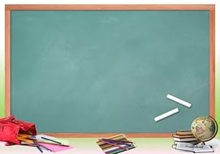
School
School

Slide 3
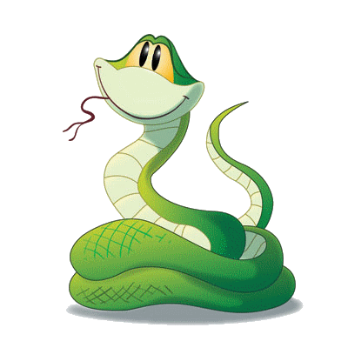
Fine the words
Schoolrupencilme
bolschoolbaglmtbooktry
rulerpanrarubberbokspencilcase

Slide 4
Phonetic exercise
Listen and read the poem.
The school.
The school has doors that open wide
And friendly teachers wait inside
Hurry, hurry, let’s go in,
For soon the lessons will begin.
Books and pencils I will need,
When I start to write and read,
Lots to learn and lots to do
I like to go to school, don’t you?

Slide 5
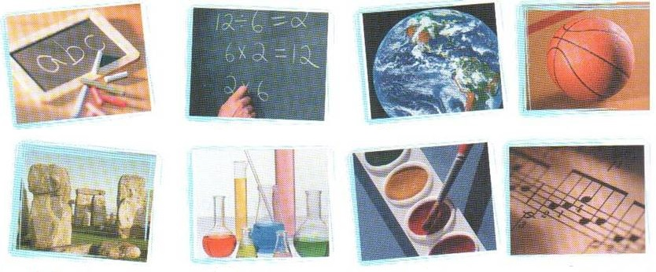
Play the game

Slide 6
What do you think about your school subjects?
English interesting History easy Mathematics Boring Biology IS Russian Exciting Kazakh difficult
Geography

Slide 7
. MATCH THE SCHOOL SUBJECTS AND THE THINGS STUDIED IN THEM
Events that happened long ago.
Figures and mathematical.
You run and jump in the Gym.
Foreign words and grammar rules.
Plants and animals.
Computers .
Stories, novels, poems .
Mountains, rivers, oceans.
You have papers and pencils,
a brush and an eraser.
History
English
Art
Geography
Maths
Information Technology
Biology
Literature
Physical Education

Slide 8
For the first group. Find the mistakes
I like Mathematics. –He…
We read History books. - He…
I play the piano. - She…
You write the exercises. - He…
They have new friends. - He…

Slide 9
The test for the second group Choose the right variant.
1. School... at 8 o’clock.
a) starts b)start c)to start
2. We ... to school 6 days a week.
a) go b)goes c)to go
3. Mathematics... me to think.
а) to teach b)teaches c) teach
4. They ... many rules.
а) learn b)learns c)to learn
5. English...me to find friends.
а) help b) helps c) to help

Slide 10
For the third group.
Find the mistakes
I likes to learn.
We plays football.
He teach Literature.
Kate learn the rules.
They has 5 main subjects at school.

Slide 11
What shouldn`t students do in school?
Don`t sleep in class
Don`t be late for class
Don`t run in the hall
Don`t throw paper
Don`t bring bubble gum to school
Don`t eat in class

Slide 12
What should students do in school?
School rule
Write carefully
Bring all your books to class
Be respectful to your teachers
Work as a team
Raise your hand
Be helpful
Be polite
Wear school uniform
Be ready for class every day
Keep good discipline

Slide 13
HOMEWORK.
Write about your school day

Slide 14
☻- OK! ☻- OK?

Slide 15
GOOD - BYE!

Slide 16
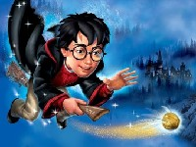

Slide 17
Dear friends,
I’m Harry Potter. I live in …
I go to …. School.
My school starts ….
We study many interesting subjects.
We …. to fly, to speak to animals.
We read … books.
My favourite subject is English of the future.
I want to learn Russian. It …. me to find friend in Russia.
Bye,
Harry Potter.
learn
magic
Howard
London
at 9 o’clock
helps

Slide 18
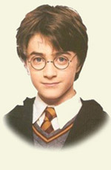
Dear friends,
I’m Harry Potter. I live in London.
I go to Howard School.
My school starts at 9 o’clock.
We study many interesting subjects.
We learn to fly. We speak to animals.
We read magic books.
My favourite subject is English of the future.
I want to learn Russian. It helps me to find friend in Russia.
Bye,
Harry Potter.

