Slide 1
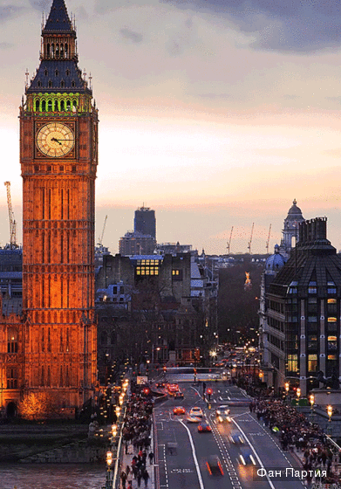
Events and facts

Slide 2
Stages:
Presentation
Who is the faster?
SMS English
Do you know?
Task for leaders

Slide 3
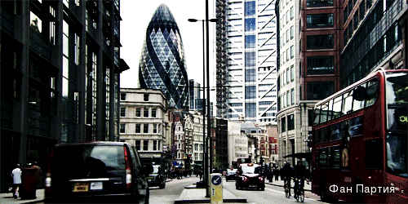
Presentation

Slide 4
Who is the faster?

Slide 5
What is your name?

Slide 6
What is your hobby?

Slide 7
What do you eat for breakfast?

Slide 8
What can you see in the fridge?

Slide 9
What is your favorite subject?

Slide 10
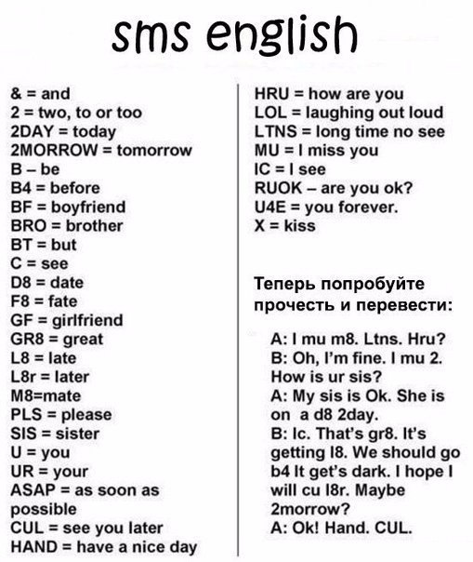

Slide 11
Task for leaders
To draw the USA’s and Great Britain’s flags on the face.

