Slide 1
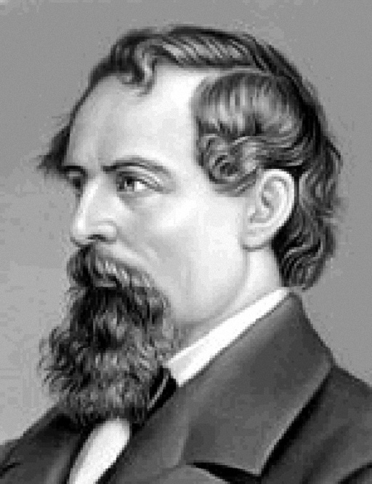
Charles Dickens

Slide 2
Charles Dickens
Charles Dickens was an English writer and social critic. He created some of the world’s most memorable fictional characters and is considered to be one of the greatest novelists.

Slide 3
Charles Dickens
He was born on February 7th, 1812 in Portsmouth, England. His father was an office man, who worked hard to provide for his family. Charles had many brother and sisters.
.

Slide 4
Charles Dickens
When he was 10, his family moved to London, where his father got into debtor’s prison. After that, Charles left school to work in a factory. For two years he worked in a dirty room pasting labels on bottles.

Slide 5
Charles Dickens
Then he went to school for three more years. He had little formal education but still succeeded in life.
.

Slide 6
Charles Dickens
Over his career he wrote 15 novels, 5 novellas, hundreds of short stories and non-fiction articles. He also worked for 20 years as an editor in a weekly journal.
.

Slide 7
Charles Dickens
He used to be a young and poor reporter at that time, who immediately became a famous writer.

Slide 8
Charles Dickens
Dickens published many other novels later. Among them “Oliver Twist”, “Dombey and Son”, “David Copperfield” and many others.

Slide 9
Charles Dickens
His books are rather interesting to read. He mostly wrote about the hard life of poor people in Victorian England. Even though he lived more than a hundred years ago, people still read his books with pleasure.
.

Slide 10
Charles Dickens
One of his most influential works ever written was “A Christmas Carol” novella.

Slide 11
Charles Dickens
Charles Dickens died on June 9th, 1870 and he was buried in Poet’s Corner in Westminster Abbey.

Slide 12
Charles Dickens

Slide 13
S | F | E | N | J | O | Y | A | B | L | E
P | I | X | E | T | U | N | M | R | O | M
O | A | C | R | E | X | E | U | C | R | E
W | I | I | T | Y | A | O | S | E | I | R
E | A | T | Y | B | O | R | I | N | G | H
R | M | I | R | T | A | E | N | Q | I | A
F | U | N | N | Y | A | O | G | A | N | Z
U | F | G | E | J | H | G | E | T | A | E
L | S | H | A | L | L | O | W | E | L | X
Y | D | E | P | R | E | S | S | I | N | G

Slide 14
Write this numbers
9th
1812
10
15
5
20
1870
7th

Slide 15
Word formation
Write-v
Writer- n
er , r
Dance
Teach
Sing
Learn
Drive

