Slide 1
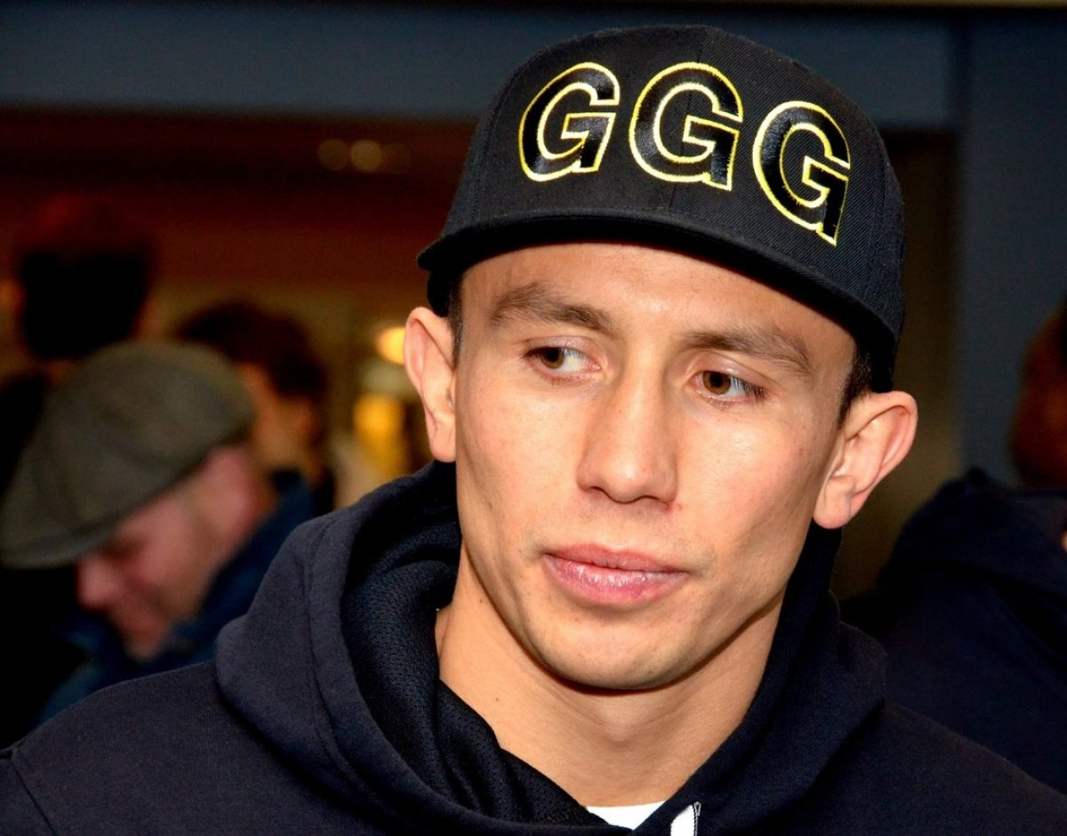

Slide 2
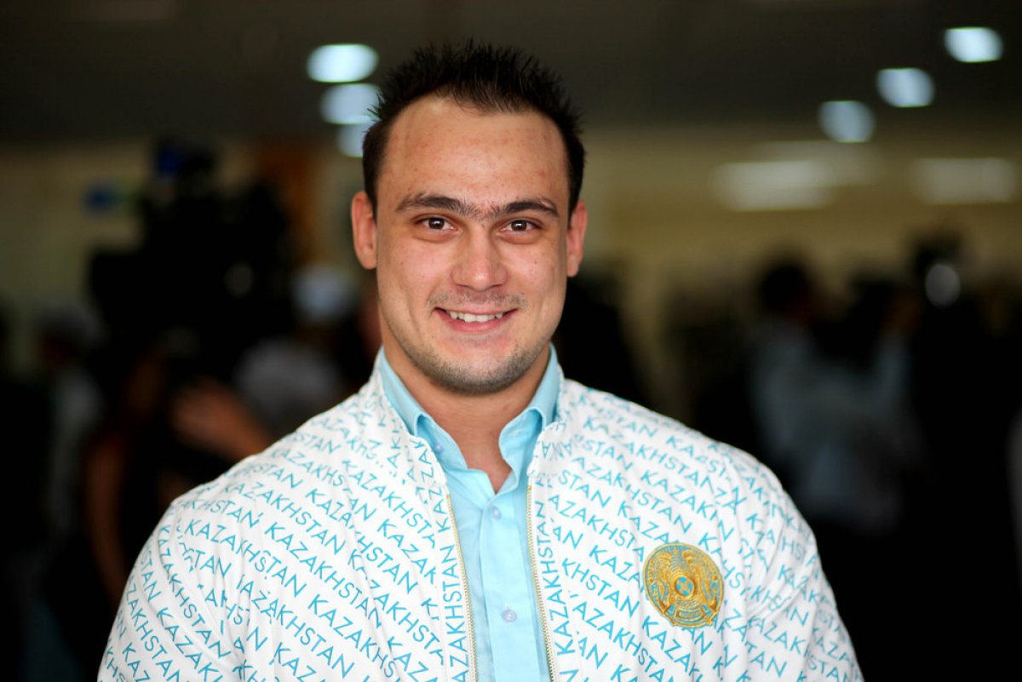

Slide 3
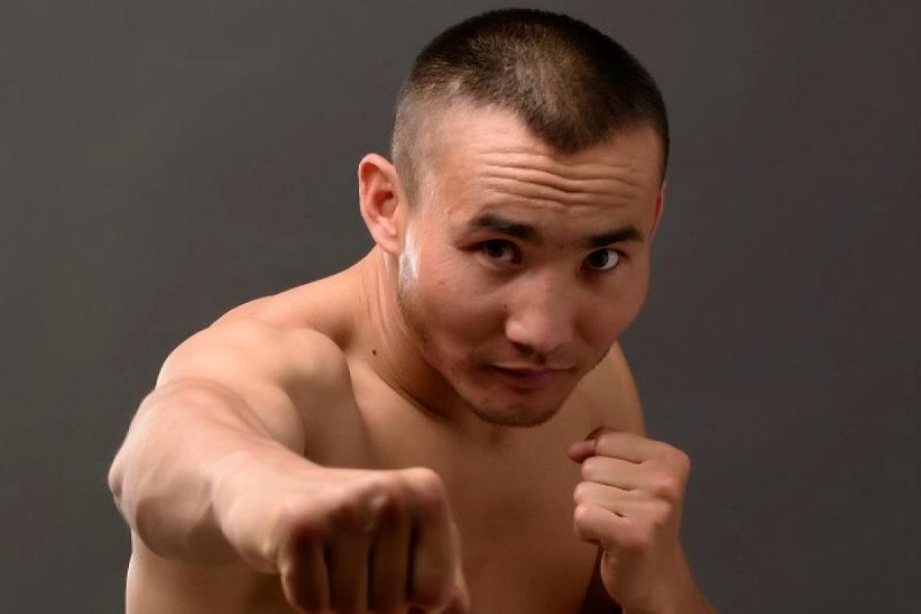

Slide 4
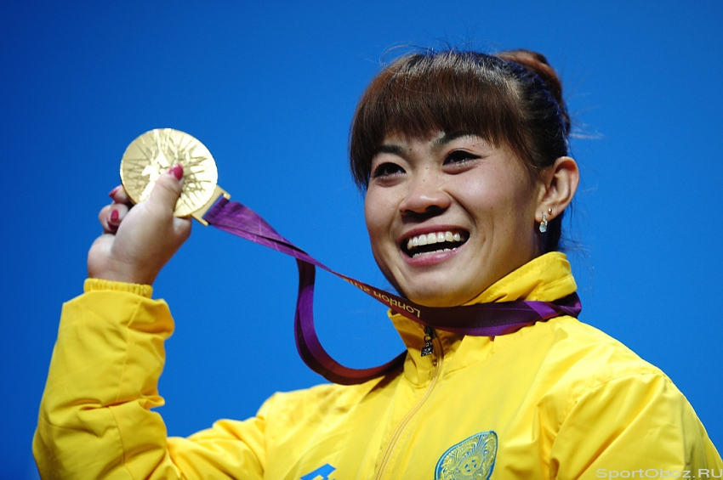

Slide 5
Football – футбол Volleyball – волейбол Tennis – теннис Hockey - хоккей Ski – кататься на коньках Basketball – баскетбол Swim - плавание

Slide 6
1
2
My name is Aidar. I’m from Astana. I’m twelve. Sport is an important part of my life. I am a boxer. But my favourite sport is swimming. My favourite sports star is Beckzat Sattarkhanov. He is a boxer.
My name is Kate. I’m from Almaty. I’m ten. I can play basketball. My favourite sport is tennis. My favourite sports star is Ilya Ilin. He’s got a gold medal in Beijing Olympic Games.

Slide 7
Name Age Come from Favourite sports Favourite sports star

Slide 8
al
all
hall
small
Walk
talk

